Slide 1


Slide 2


Slide 3

File Upload
Text File Display
New Game
Notification

Slide 4

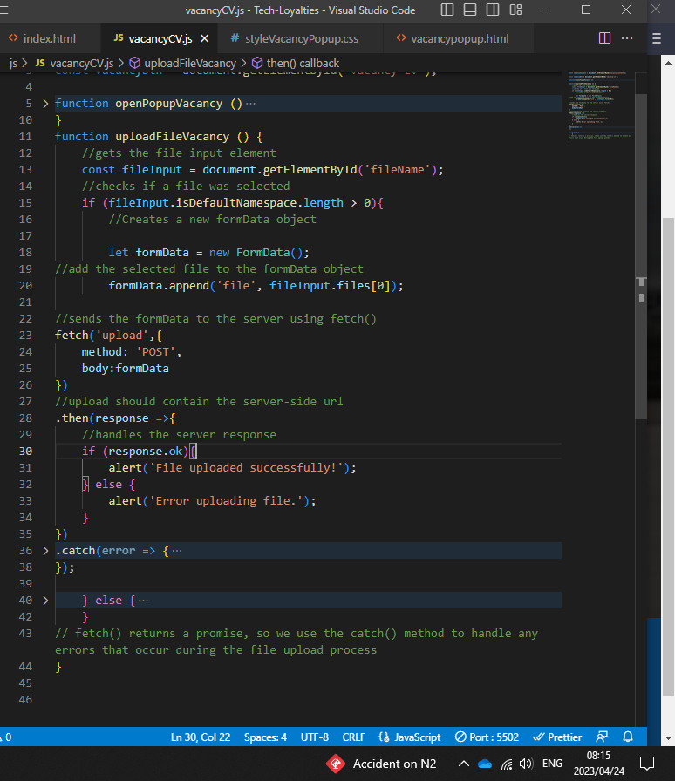
STAFF CV UPLOAD

Slide 5
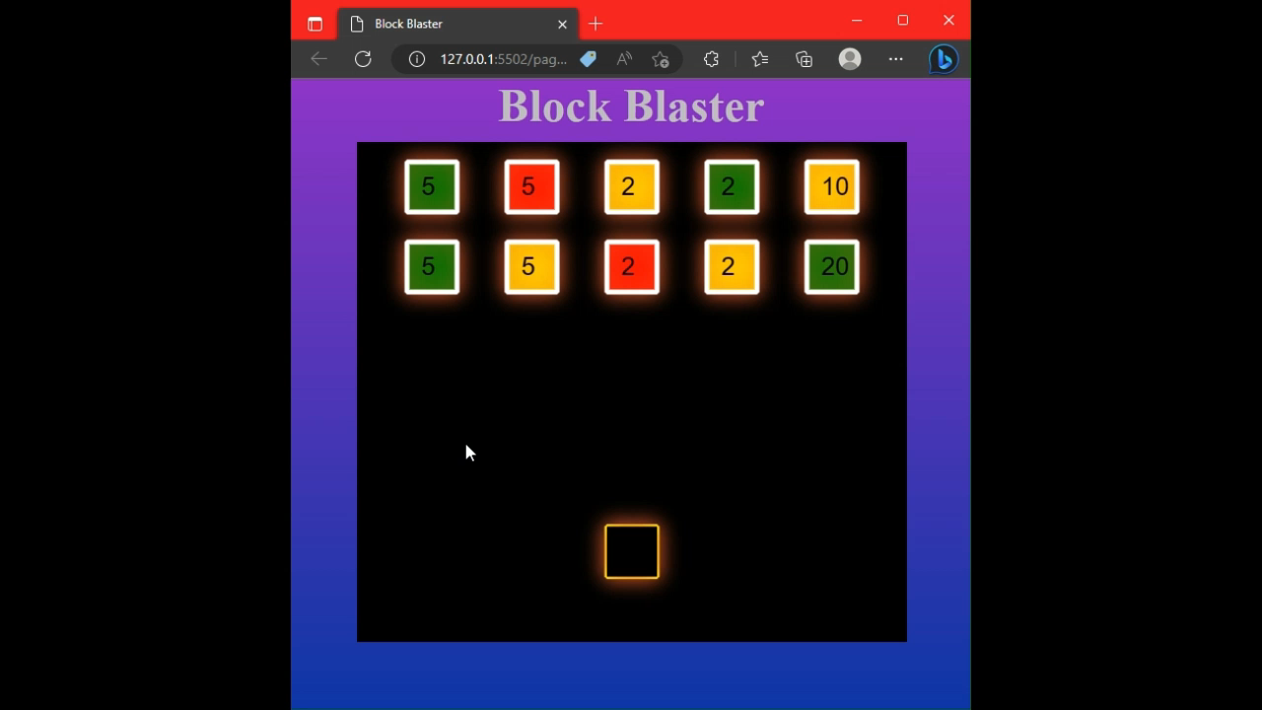
Block Blaster

Slide 6

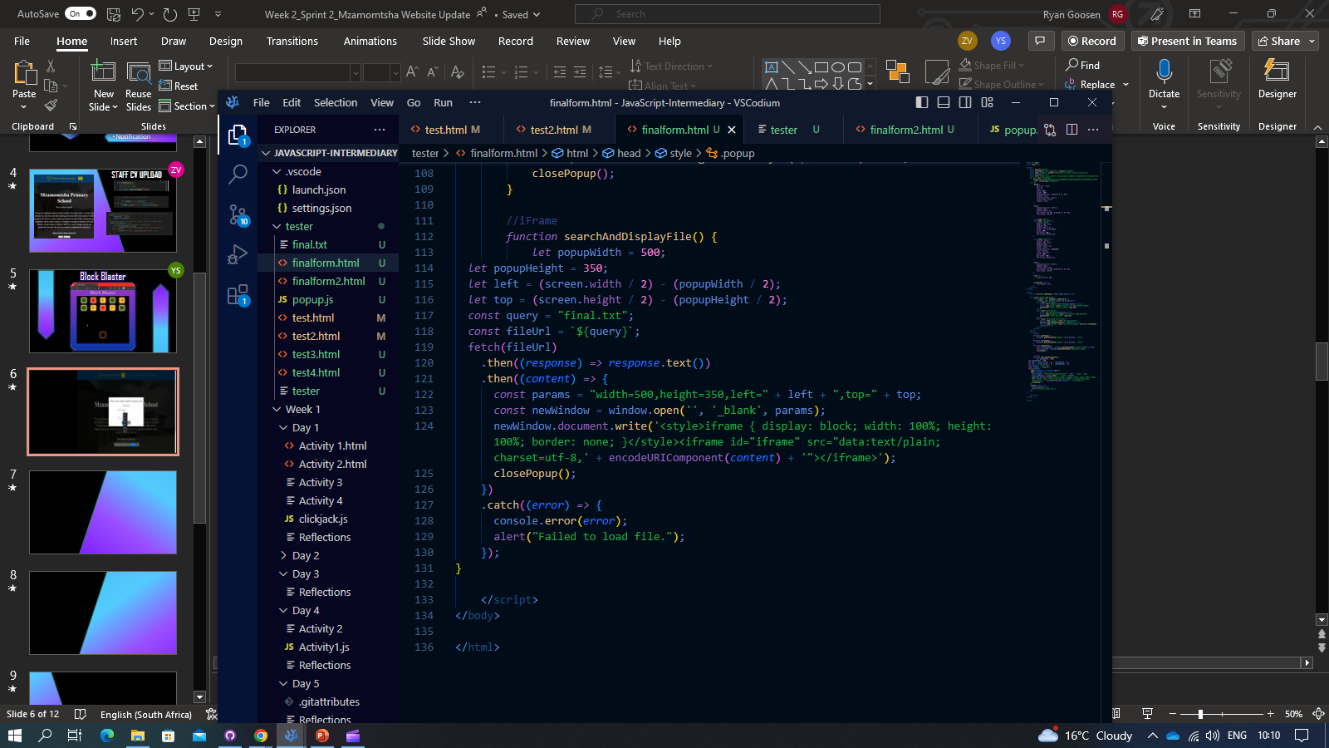
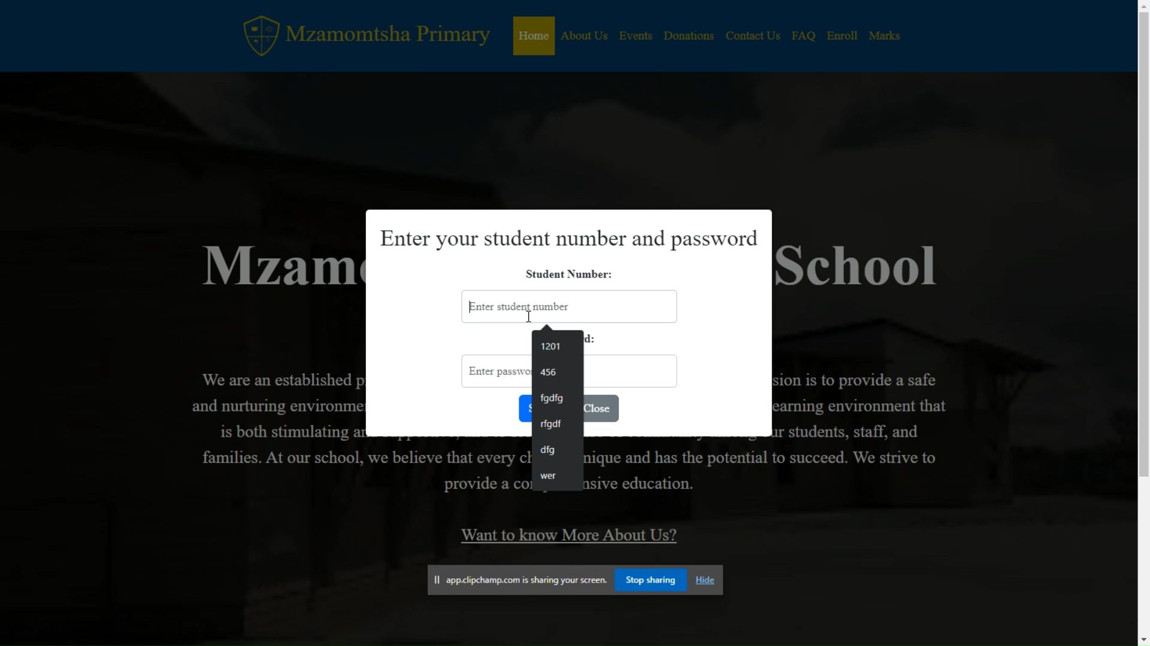
Score Card
The Sauce
The Meal
Title

Slide 7
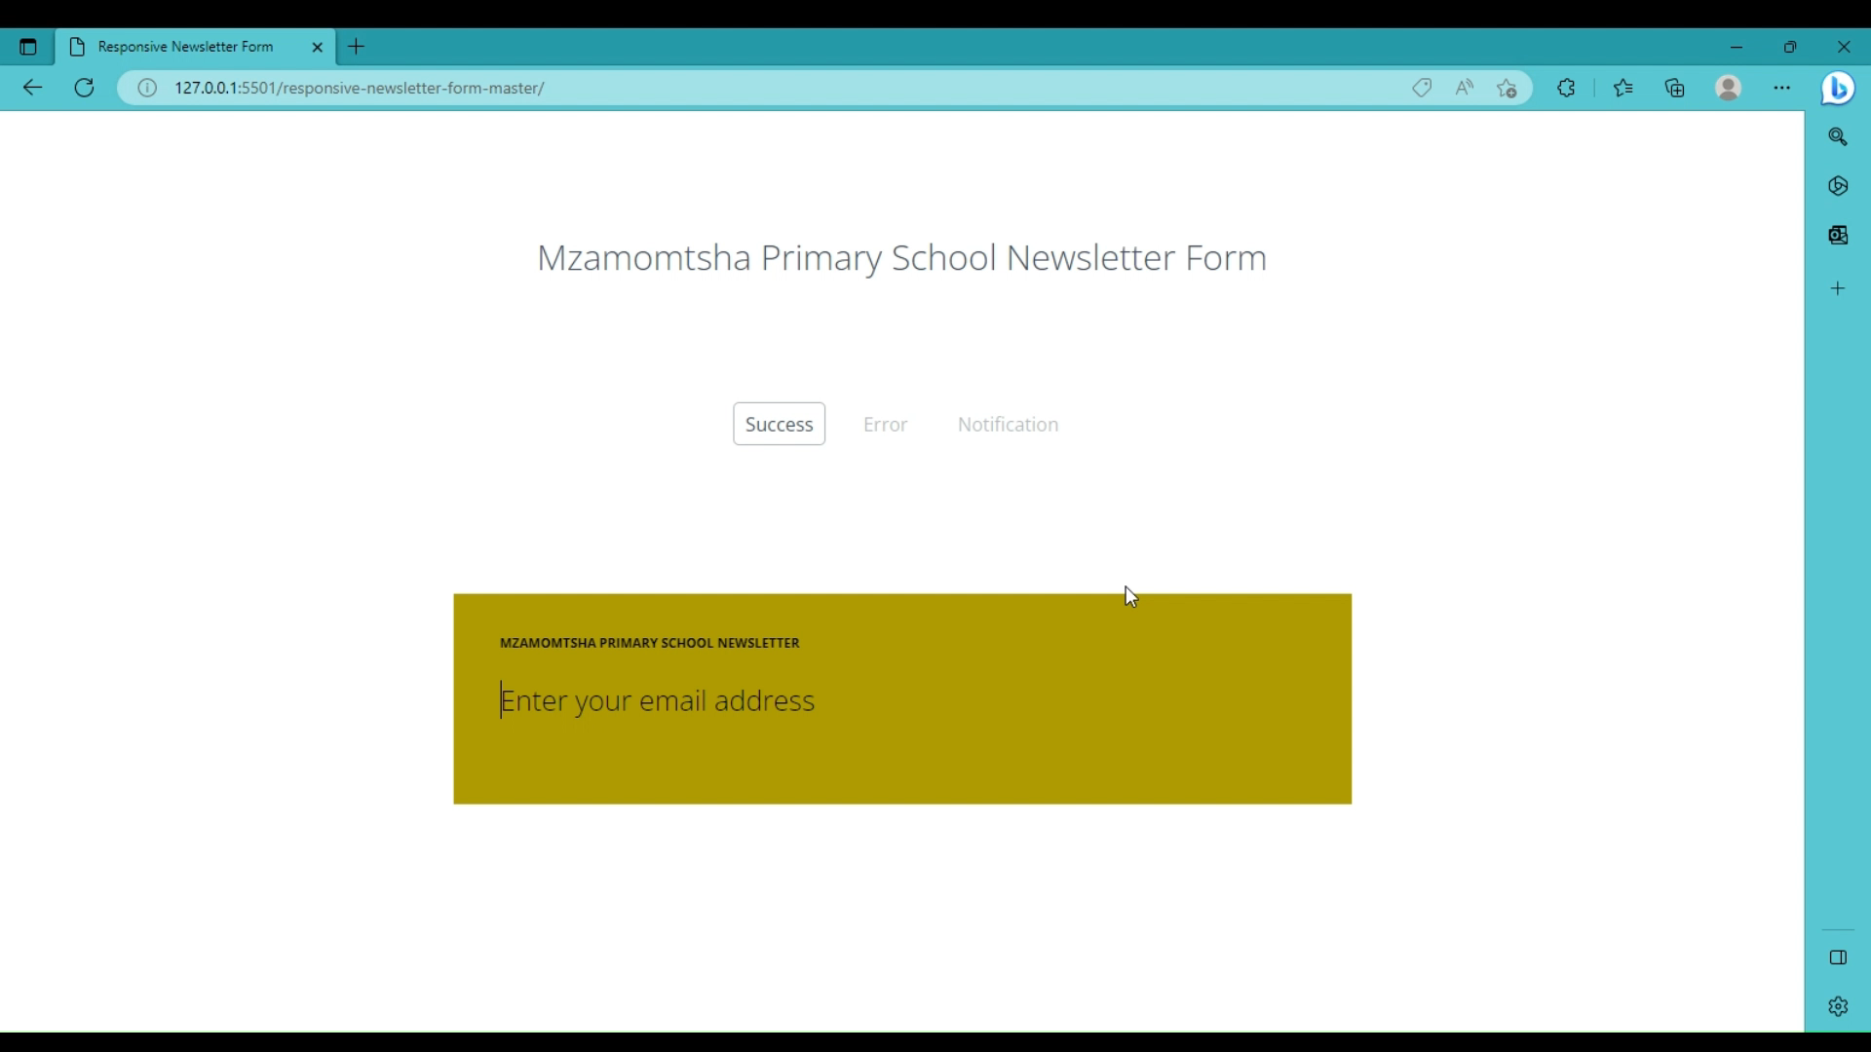
Notifications
var emailInput = $(this)
function showMessage()
//if transitions are not supported - show messages
if($('html').hasClass('no-csstransitions')) {
showMessage();
}

Slide 8


Thank You

